Slide 1
Bacalaureat results from 2019 - visual analysis
Madalina-Mihaela Badescu,
Liviu Bouruc,
Andrei-Eduard Constantinescu
511

Slide 2
TABLE OF CONTENTS
01
02
03
Dataset
Visualisations
Conclusion

Slide 3
Dataset
Bacalaureat results from 2019 (session I) from: https://data.gov.ro/dataset/rezultate-bacalaureat-sesiunea-i-2019
SIRUES codes from: https://eprofu.ro/docs/tehnic/institutii/retea-scolara.xls

Slide 4
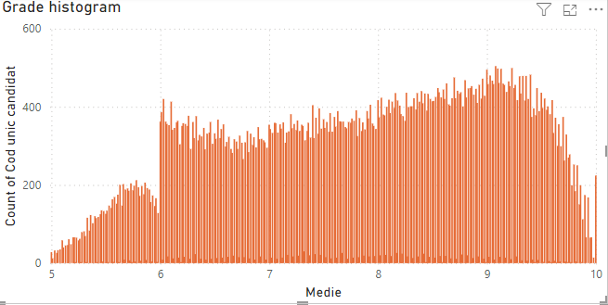
Visualisation

Slide 5
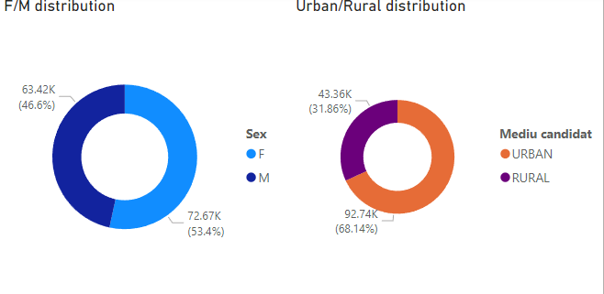
Visualisation

Slide 6
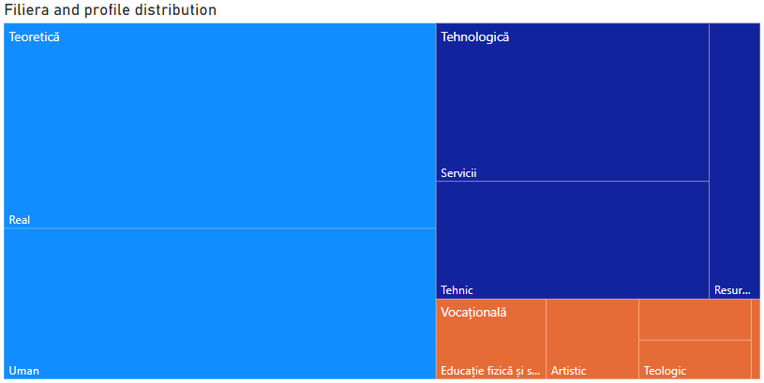
Visualisation

Slide 7
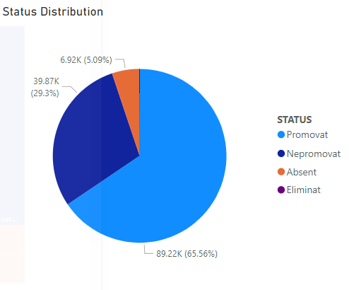
Visualisation

Slide 8
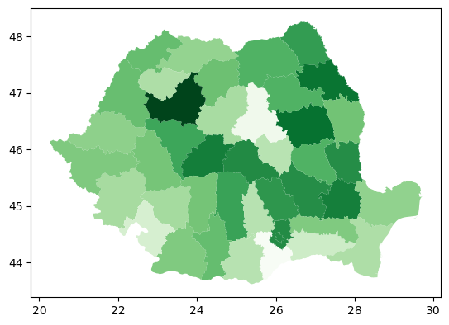
Visualisation

Slide 9
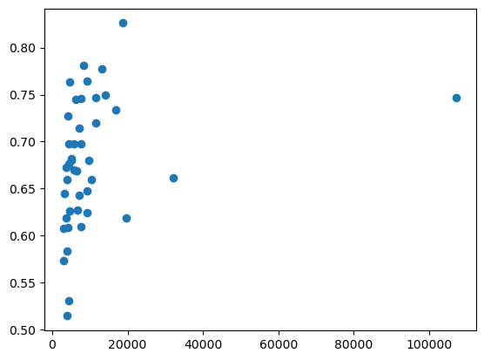
Visualisation

Slide 10
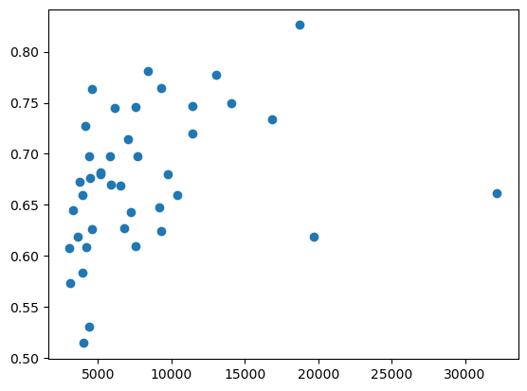
Visualisation

Slide 11
Conclusion

